Slide 1
For DKE students

Slide 2
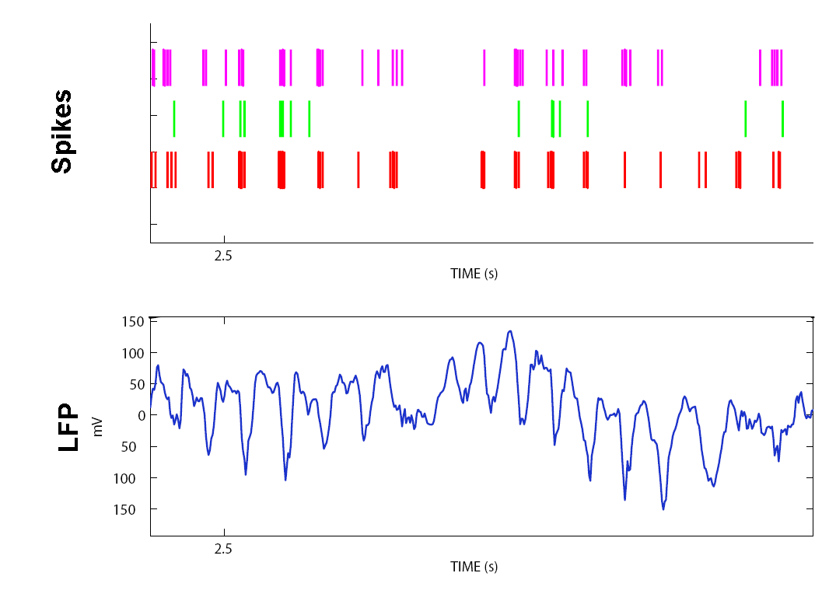
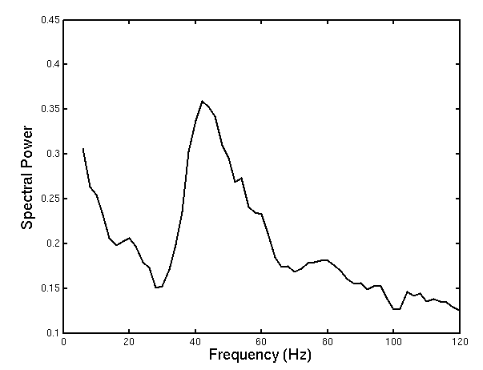
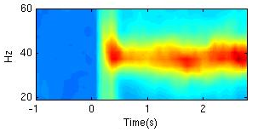
Communication in neural networks
Spikes are not random in time
Spikes from multiple neurons are correlated
Spikes are locked to LFP
LFP rhythm assessed by Fourier-transform power spectrum

Slide 3
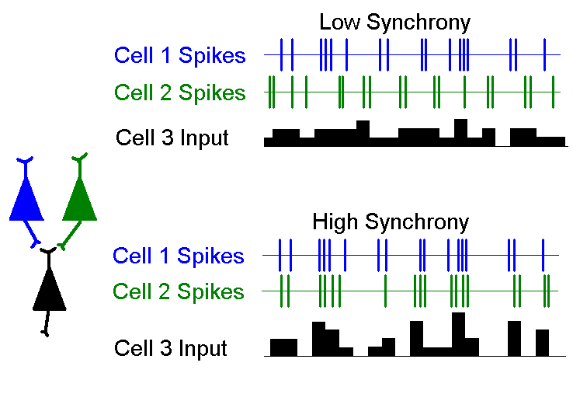
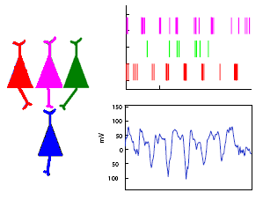
Neurons spike with high or low synchrony
High synchrony spikes have a high impact on following neurons
Neurons can be synchronous with follower neuron state
Only these have effective connections

Slide 4
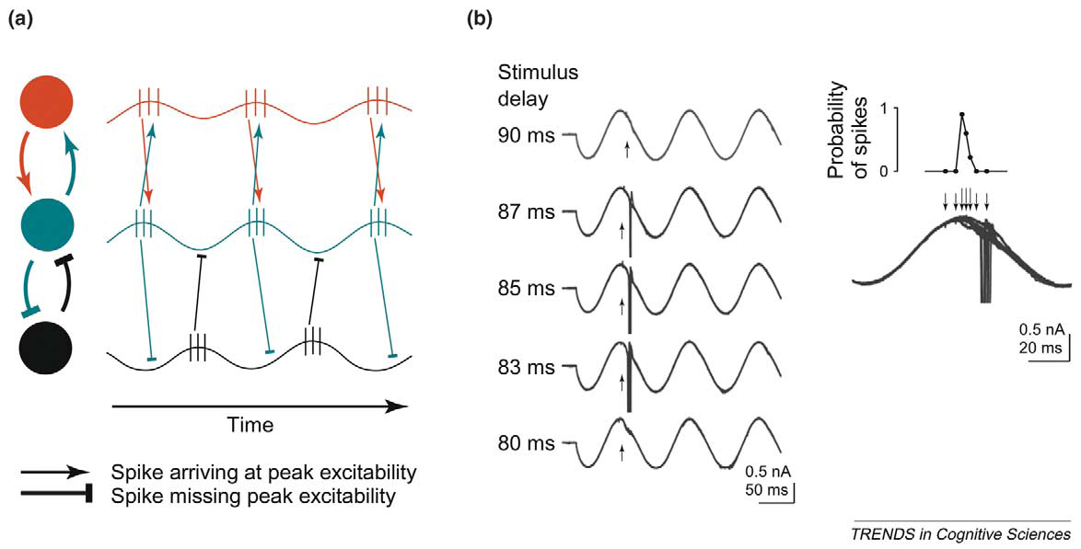
Neuronal communication between areas
Timing of incoming spike relative to oscillation phase affects output spike probability
Fries (2005)

Slide 5
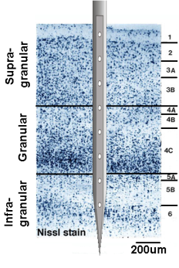
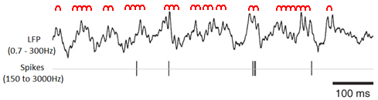
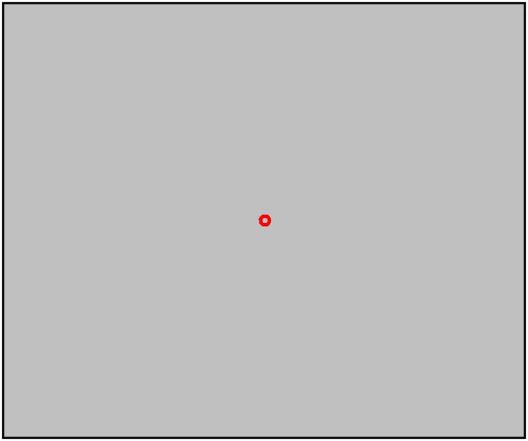
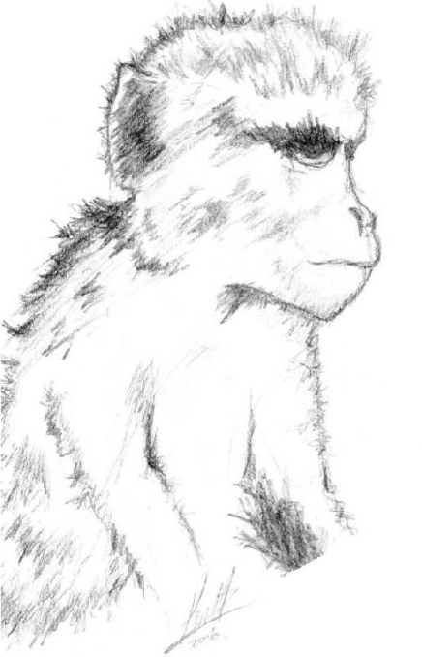
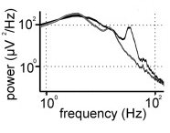
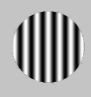
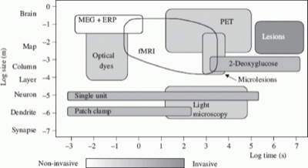
Recording in Macaque visual cortex
Alpha:
Feedback
Inhibition of distracters
Gamma:
Feedforward
Selective communication
Multiple laminar probe
Laminar probe
Notes:
5

Slide 6
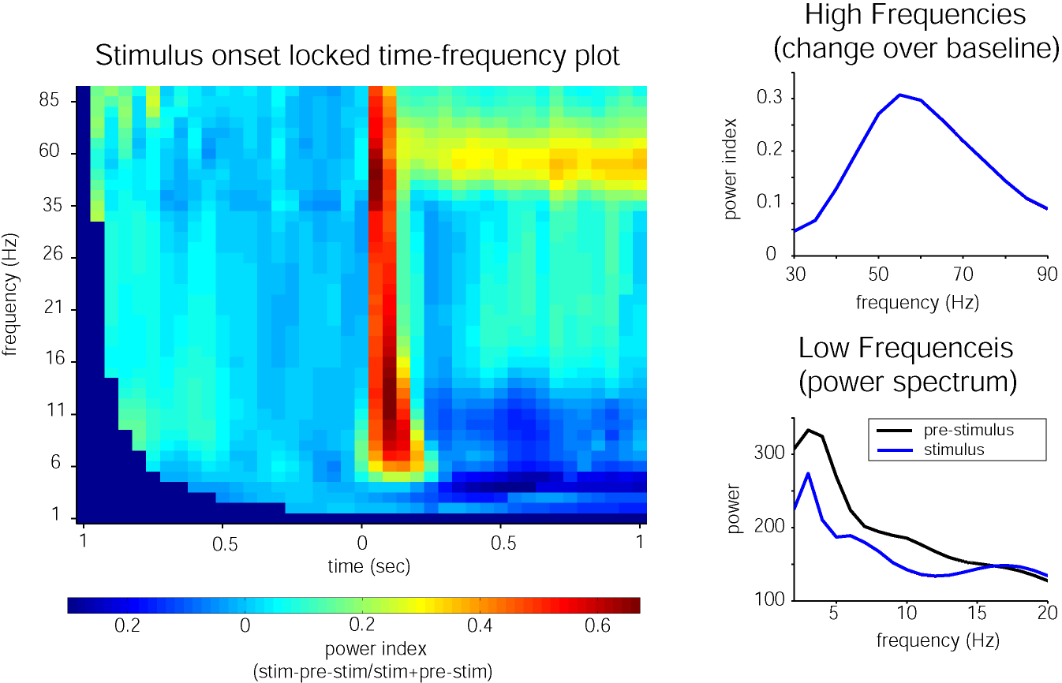

Frequency response

Slide 7
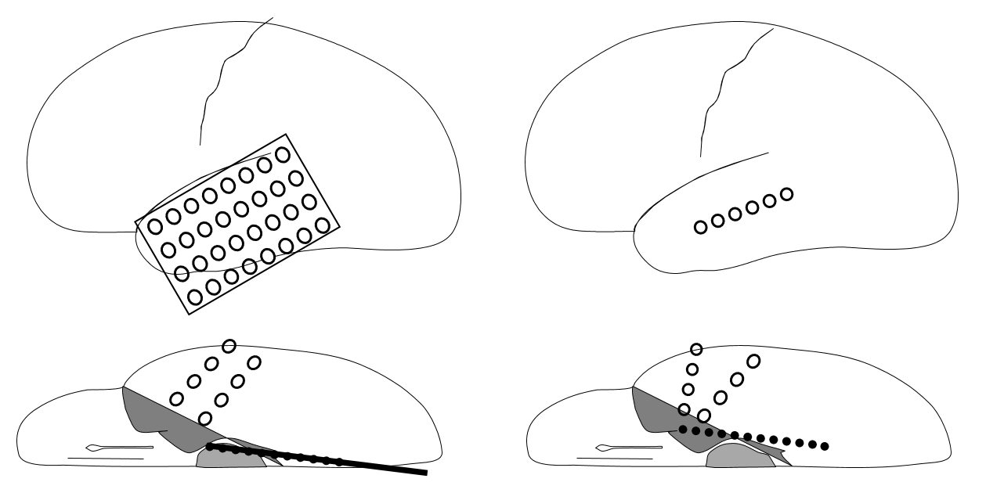
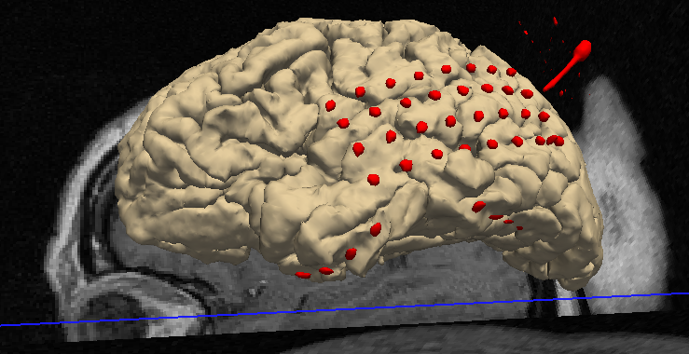
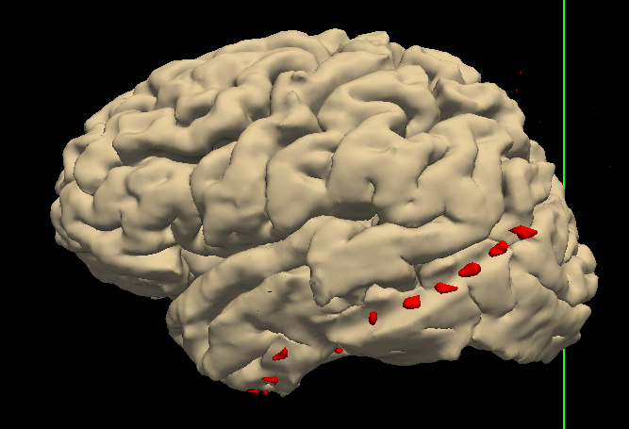
Recording in Human cortex and hippocampus
Implantation is dependent on presentation of individual patient.
Two typical implantation schemes:
Temporal grid vs strip
Basal temporal strips
Hippocampus depth electrode (10 or 12 contacts)
Either lateral or bilateral
1cm inter-contact spacing
~ 1 patient per month

Slide 8
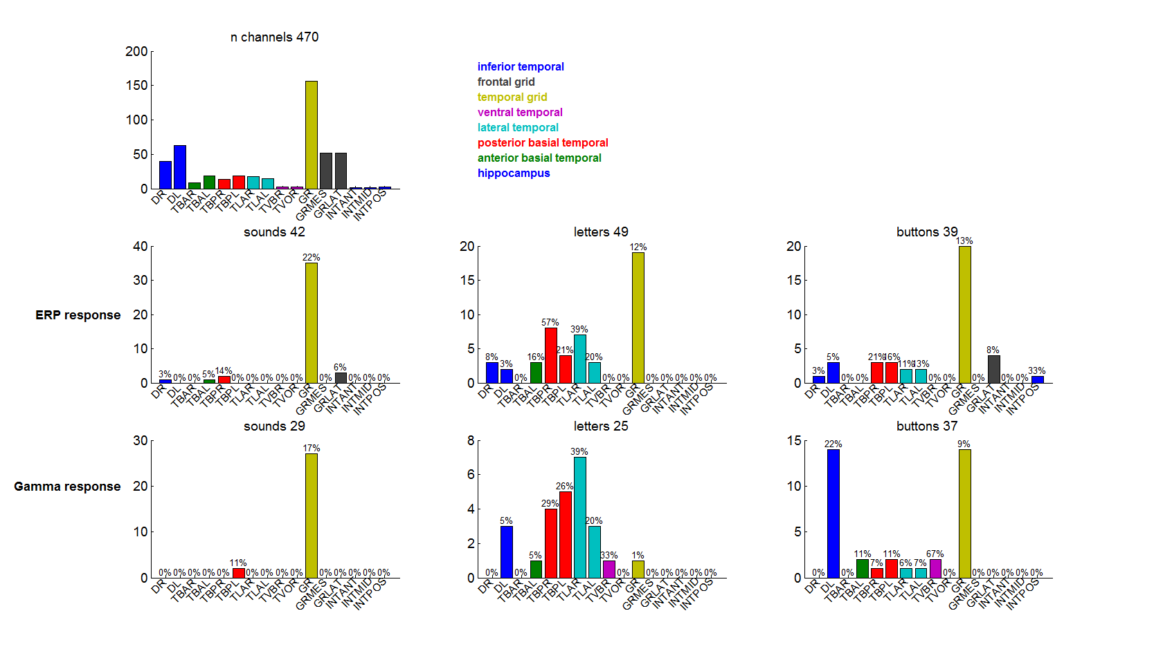
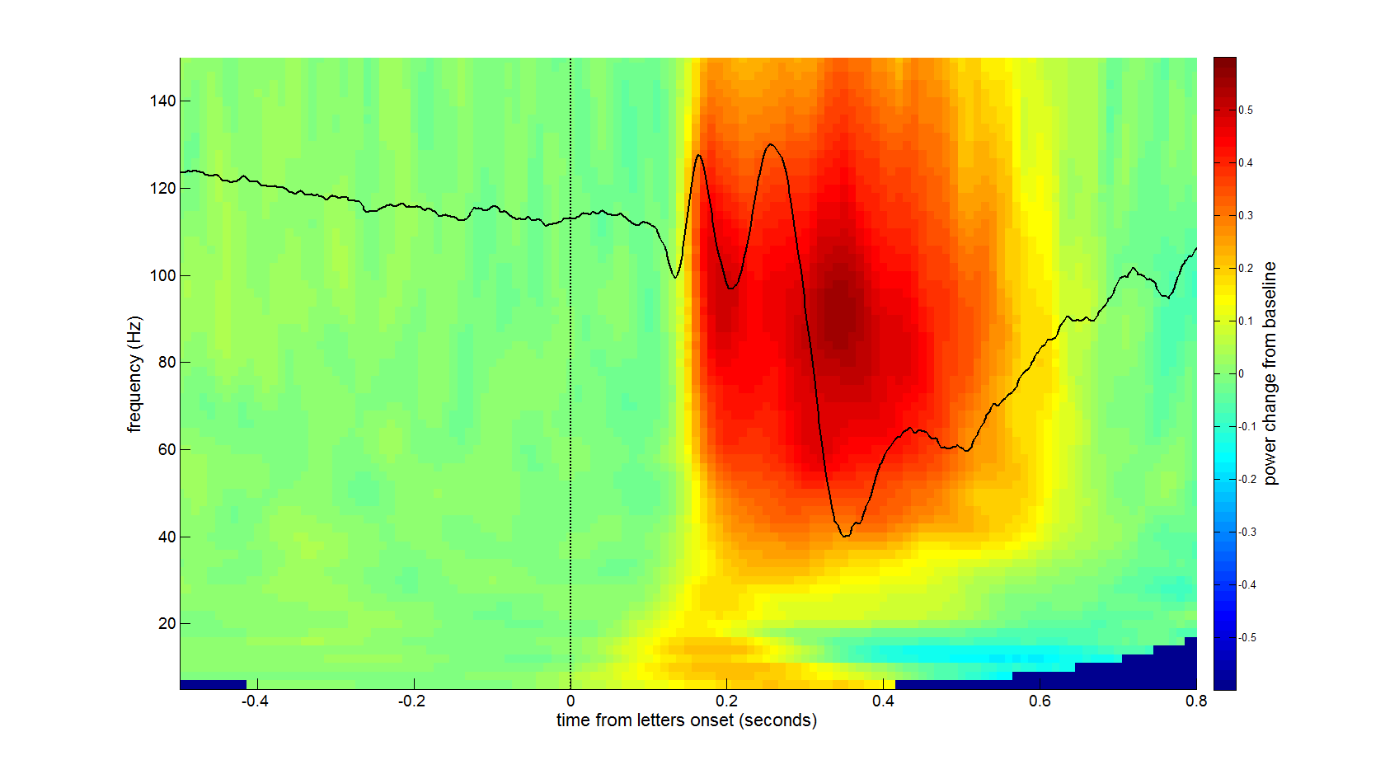
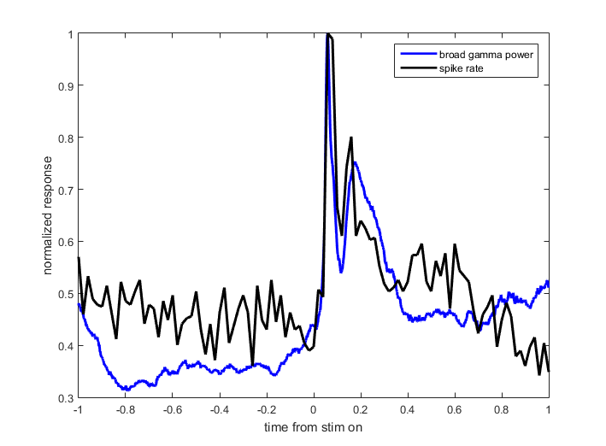
Responsiveness in Human ECOG
8 patients, 470 channels
4 to 11 sessions of 20 to 40 min beginning 2nd day after implantation
Auditory responses on the superior temporal cortex
Visual responses on basal temporal cortex
Distributed response during button presses
Similar distribution for ERP and board-band gamma (MUA)

Slide 9
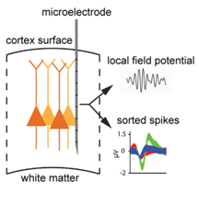
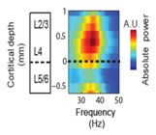
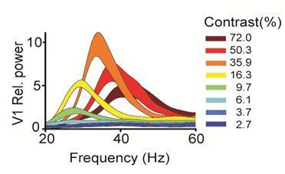
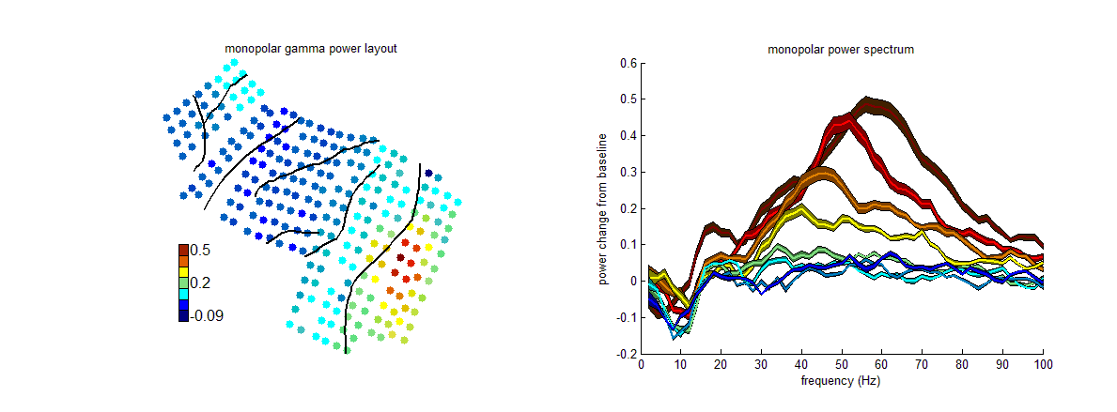
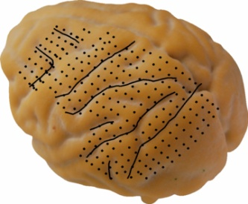
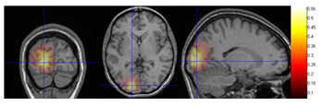
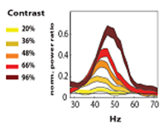
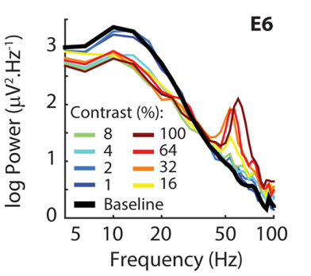
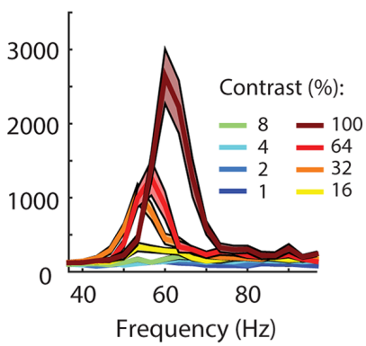
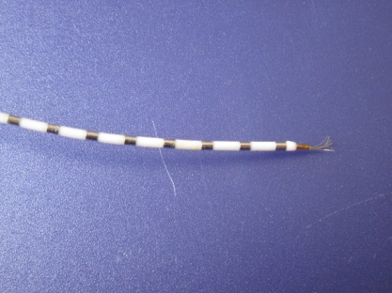
Comparison across species and scales
Gamma band peak frequency was once thought to be fixed
But we have shown in a range of settings peak frequency is related to stimulus contrast
Macaque spikes &
LFP
Macaque ECoG
Human
MEG
Human
iEEG &
spikes
iEEG
SU/MU
Self*, Peters* et al, 2016, PLOS Biology

Slide 10
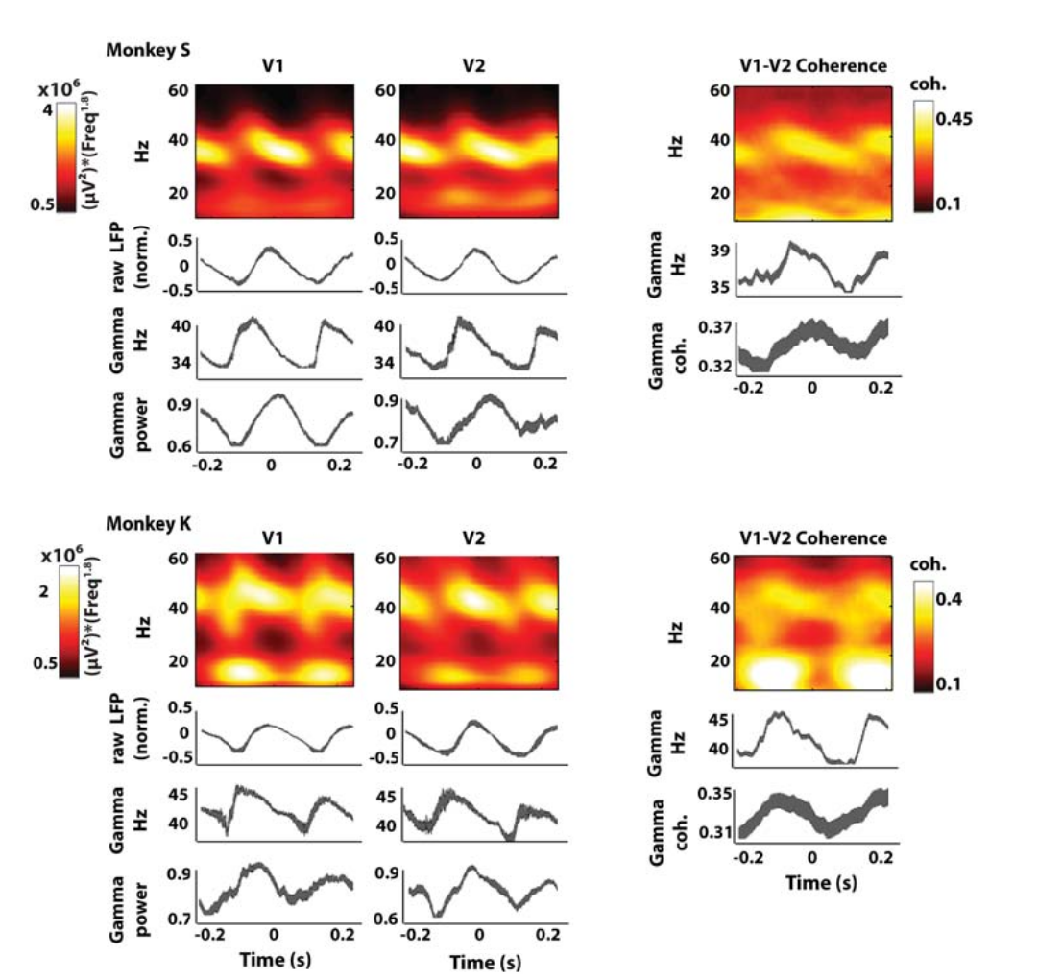
Neuronal oscillations are not stable
TFR analysis centered on theta peaks
Systematic modulation of power and frequency
Cross area coherence also happens in bursts within the theta cycle
Lowet et al, Europian Journal of Neuroscience

Slide 11
Summary
Neuronal population (are thought to) communicate by aligning periods of responsive-receptive phases of rhythmic periods.
Neuronal rhythms can be looked for in spiking, LFP or EcOG
Stimulation leads to increase in high frequency power and decrease in low frequency power
Neuronal oscillations are not stable but center frequency of varies with time and stimulus

Slide 12
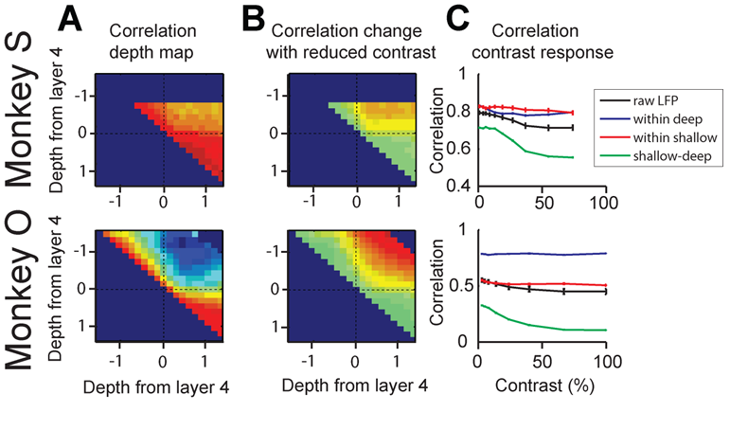
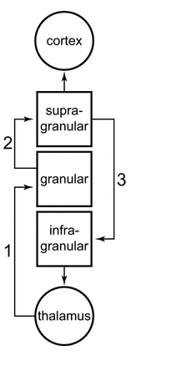
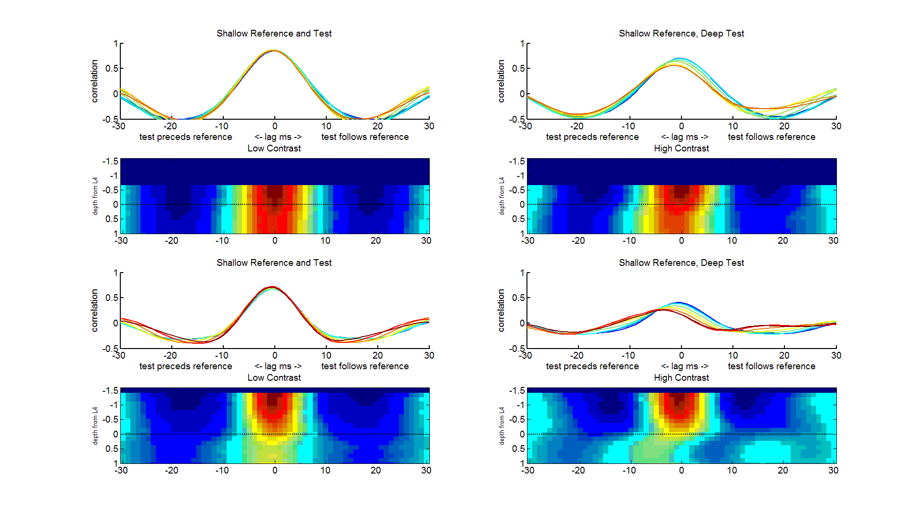
Within-column communication
Communication happens over fixed anatomical pathways
The consequence of anatomical constraints can be observed functionally

Slide 13
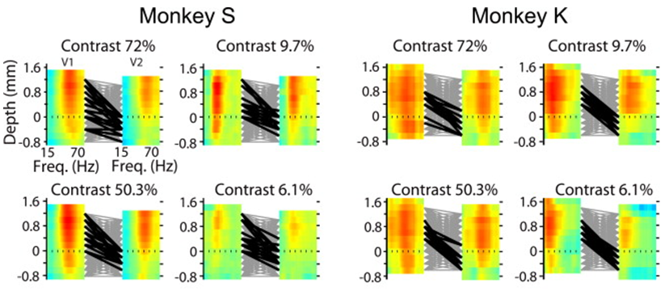
Between-area functional feedforward connectivity
Roberts et al., Neuron, 2013

Slide 14
Feedforward vs Feedback changes
Roberts et al., Neuron, 2013

Slide 15
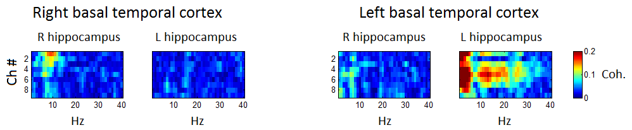
Human cortex-hippocampus coherence
Alpha coherence between cortex and hippocampus is higher within hemisphere than across

Slide 16
Summary
Communication between neuronal populations is constrained by feed-forward and feed-back anatomical connections
How can we assess functional communication given the complex nature of neuronal oscillations?
Within cortical columns?
Between cortical areas?

Slide 17
Post-discussion 2/15/2017
What is the current state of the art with regard to non-linear and non-stationary measures of directionality/causality?
Do they provide information about at what frequency the causality occurs?
Do they take into account more than two recording sites – multivariant data?
How to assess causality between different frequencies ranges? (cross frequency coupling)
Can we look for shifting causality over time e.g. cortex to hippocampus during encoding, hippocampus to cortex during recall

